Slide 1

XSecure
secure file-sharing application.

Slide 2

Group members
Yasser Abdalmohsen Alburaidi
Anas Waleed Bajunaud

Slide 3

introduction
we designed a secure file-sharing application. that software to encrypt the file and send it over the internet using both symmetric and asymmetric key approaches.

Slide 4
GUI application
Login
Encrypt
Decrypt

Slide 5
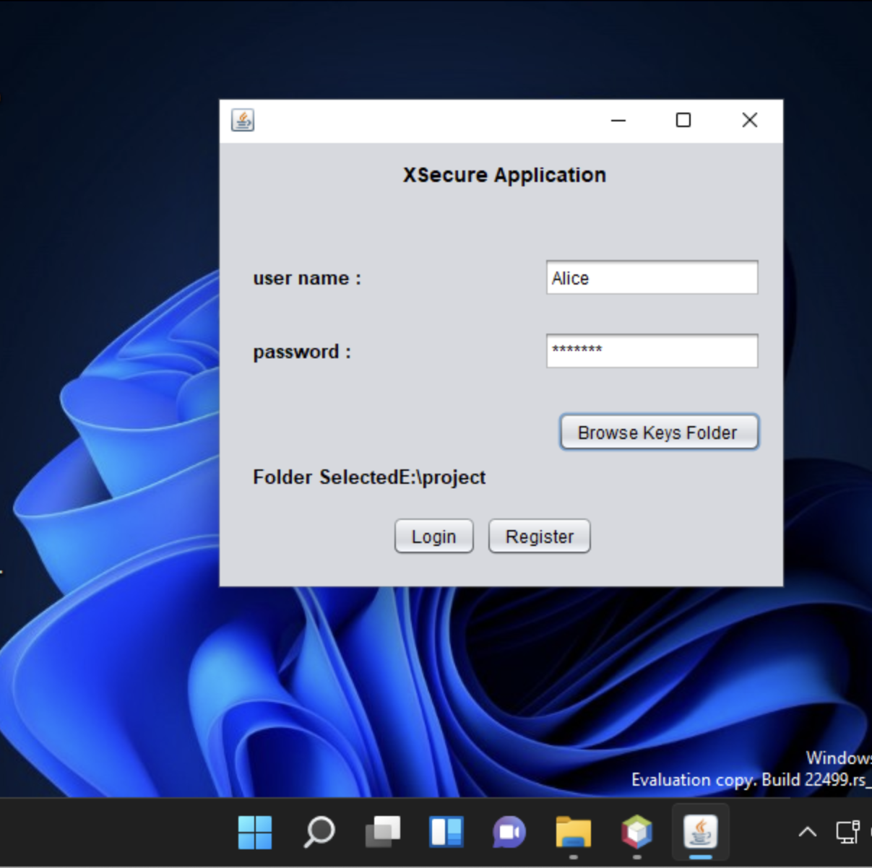
Login window
to log in to the application, by his/her username and password if registered. If not, must create a username and password. then it's created public and private keys by.

Slide 6
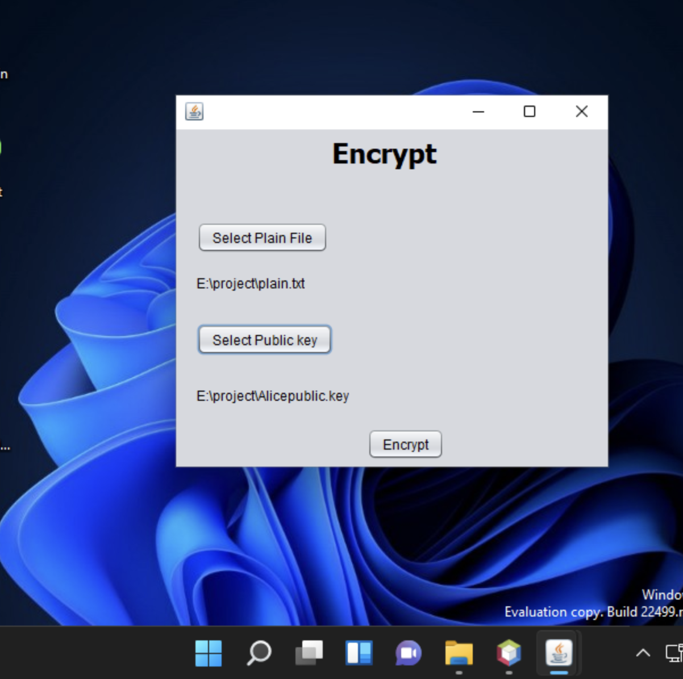
Encrypt window
the application used the RSA algorithm to encrypt the plain text by symmetric-key using the receiver’s public key.

Slide 7
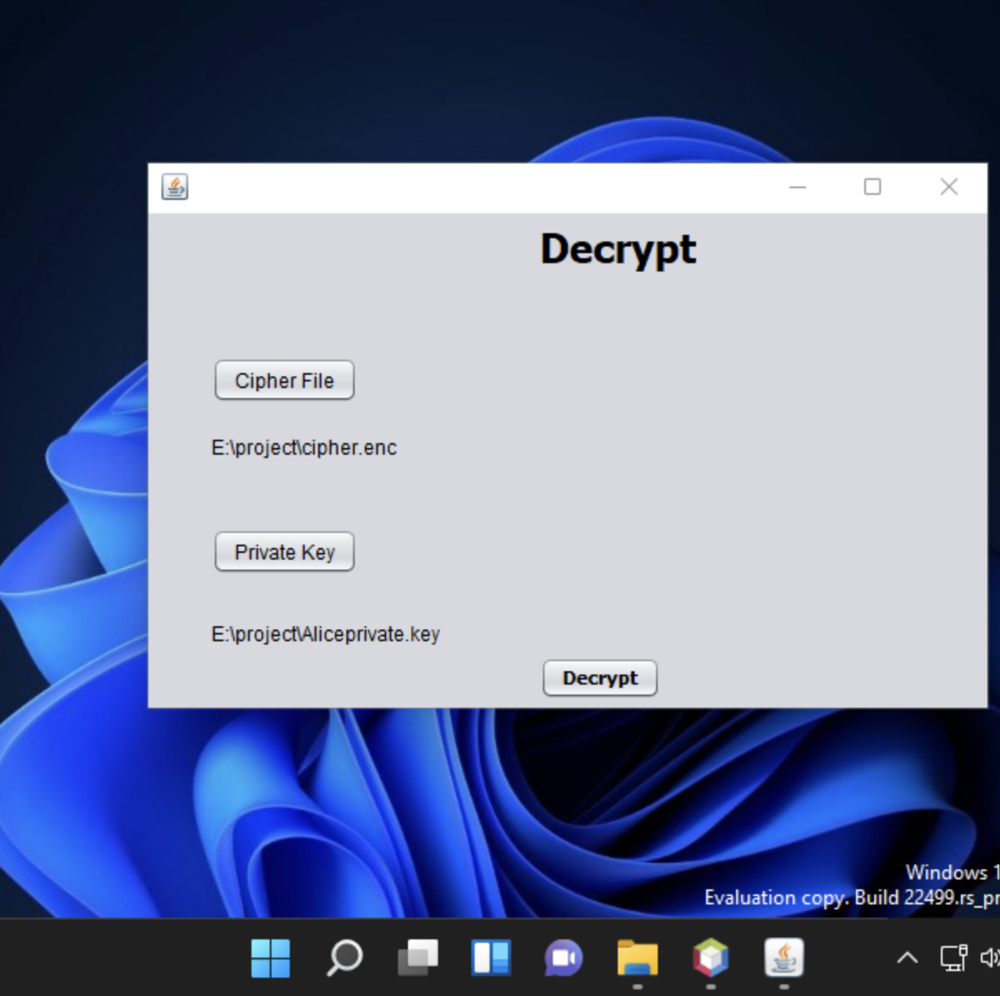
Decrypt window
the receiver used its private key to decrypt the symmetric key and then used that symmetric key to decrypt the cipher text.

Slide 8
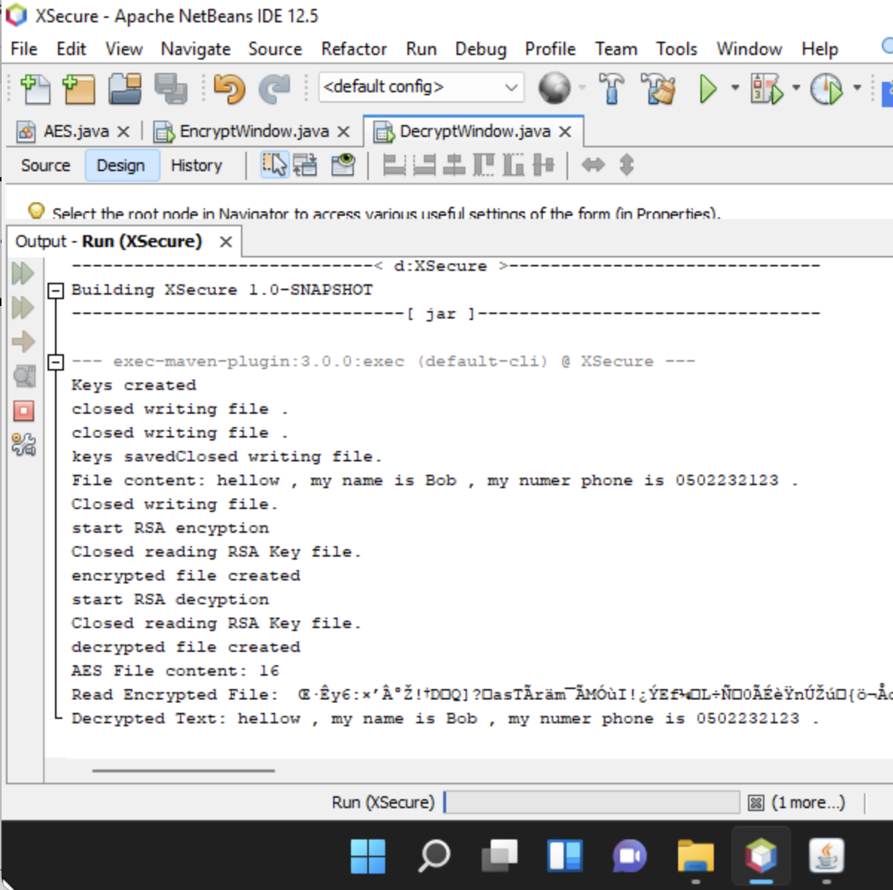
The output
the output of the application codes

Slide 9
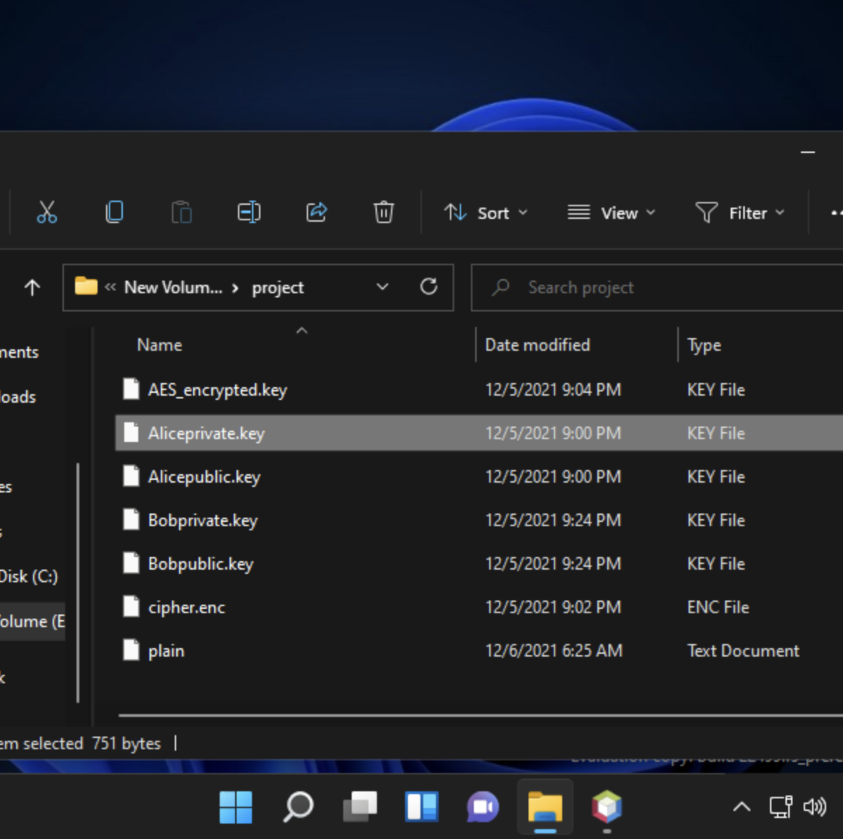
The file
The private / public keys are stored securely in a protected file.

Slide 10

Challenges
Store byte Array in file RSA,AES
Use big integer
Arrange steps for encryption and decryption

Slide 11

Thank you
For your time

